Slide 1
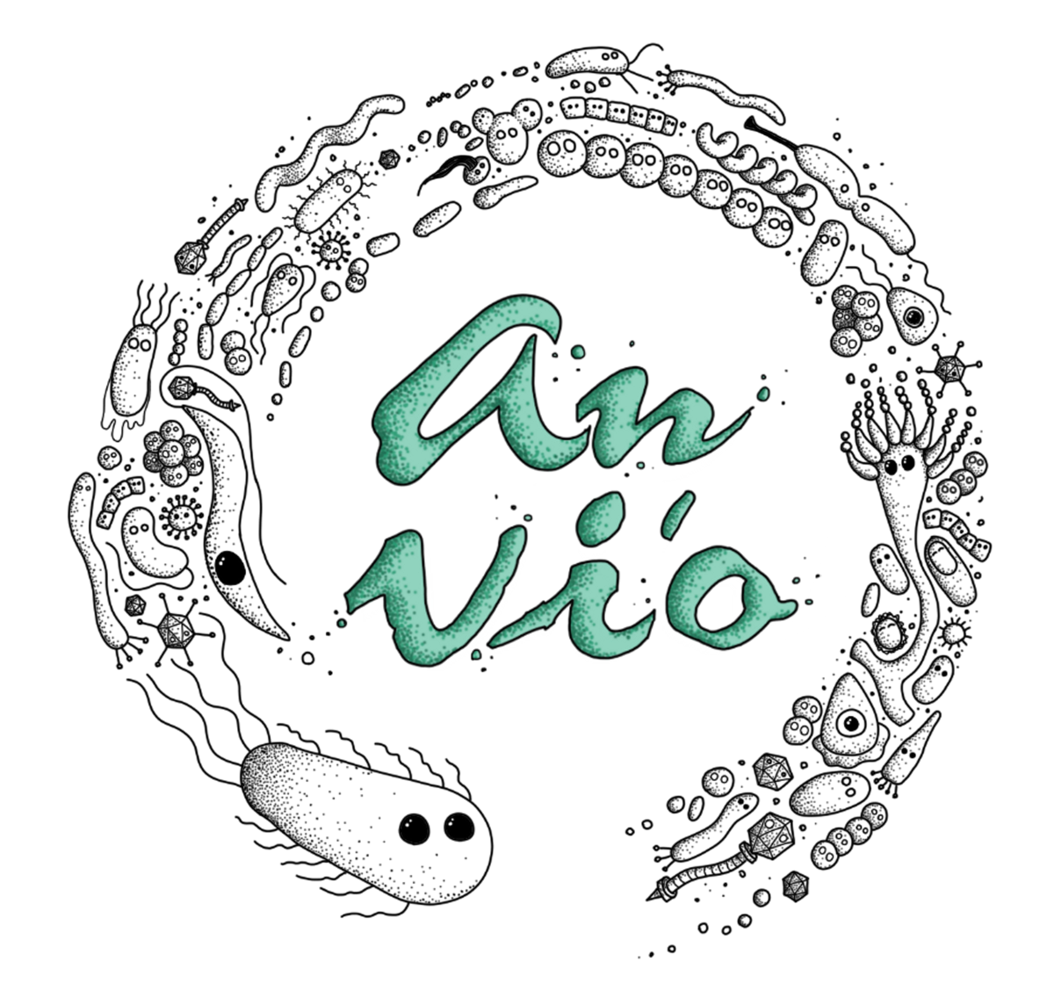
Single-cell genomics with anvi’o
Bigelow Laboratory for Ocean Sciences
April 7, 2022

Slide 2
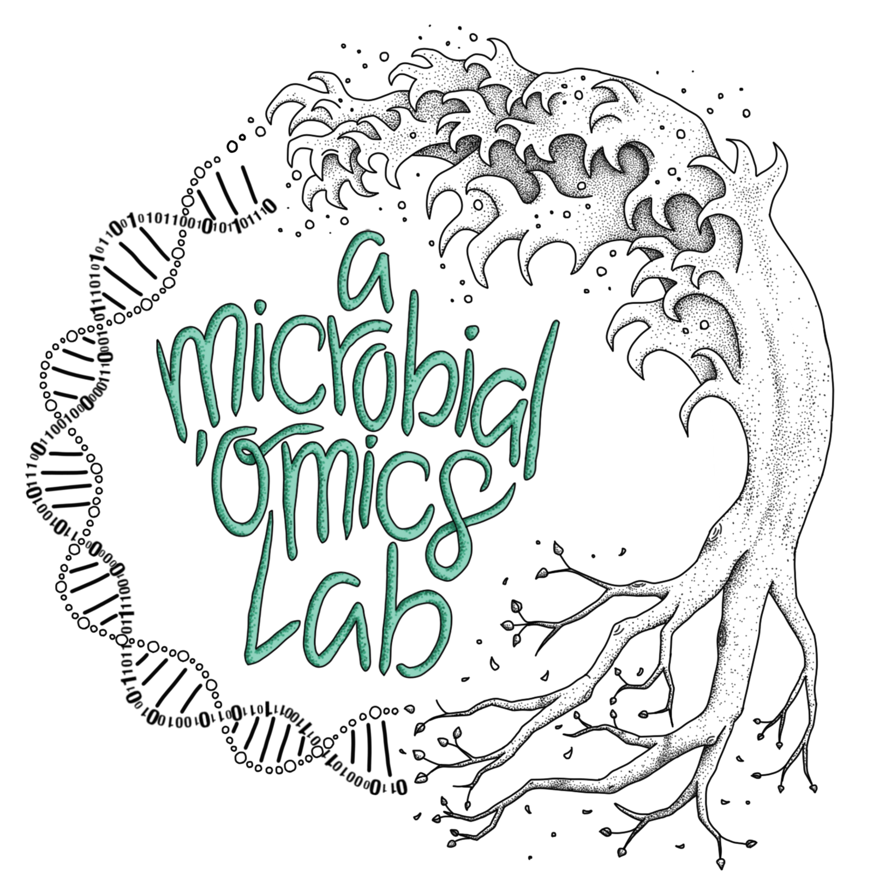
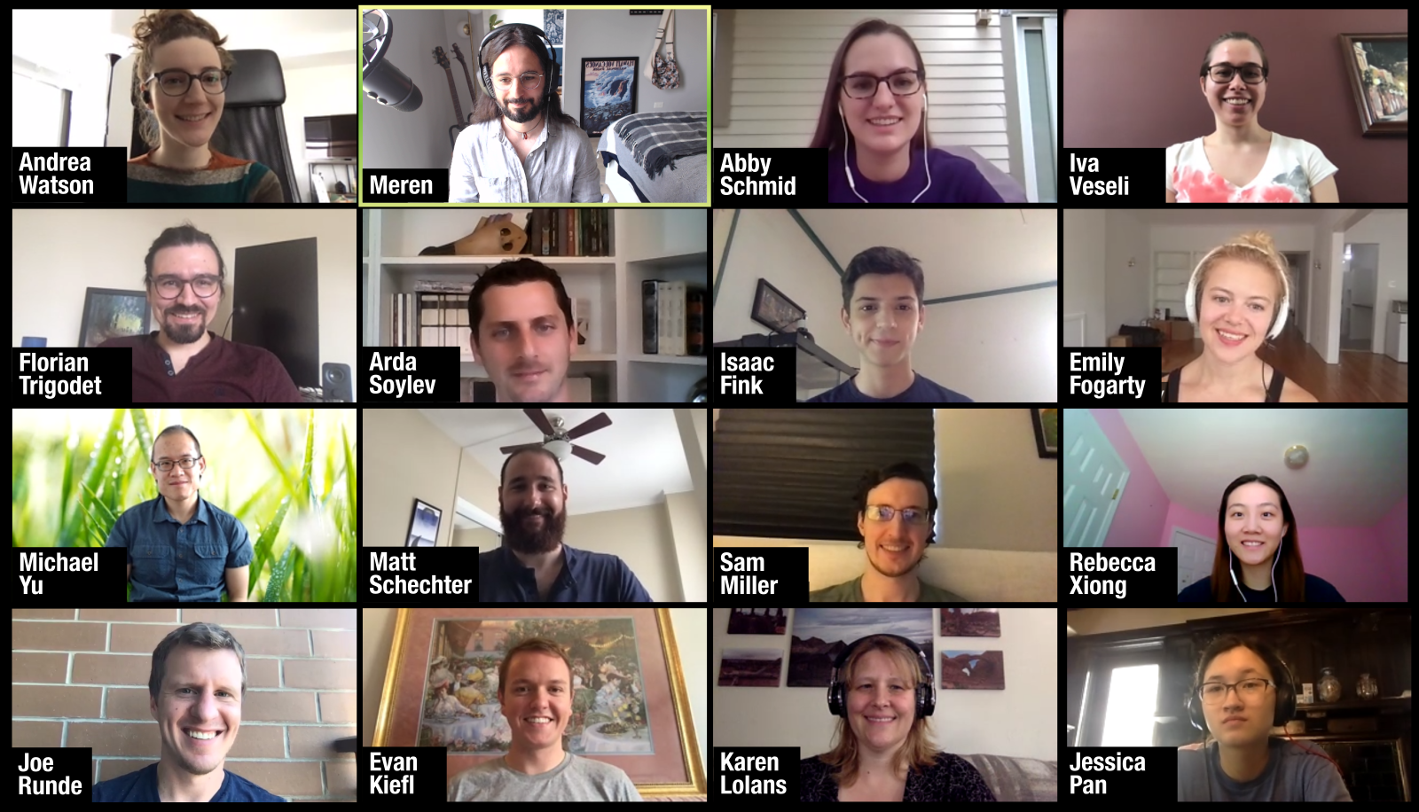
Who we are

Slide 3
A brief introduction to anvi’o

Slide 4
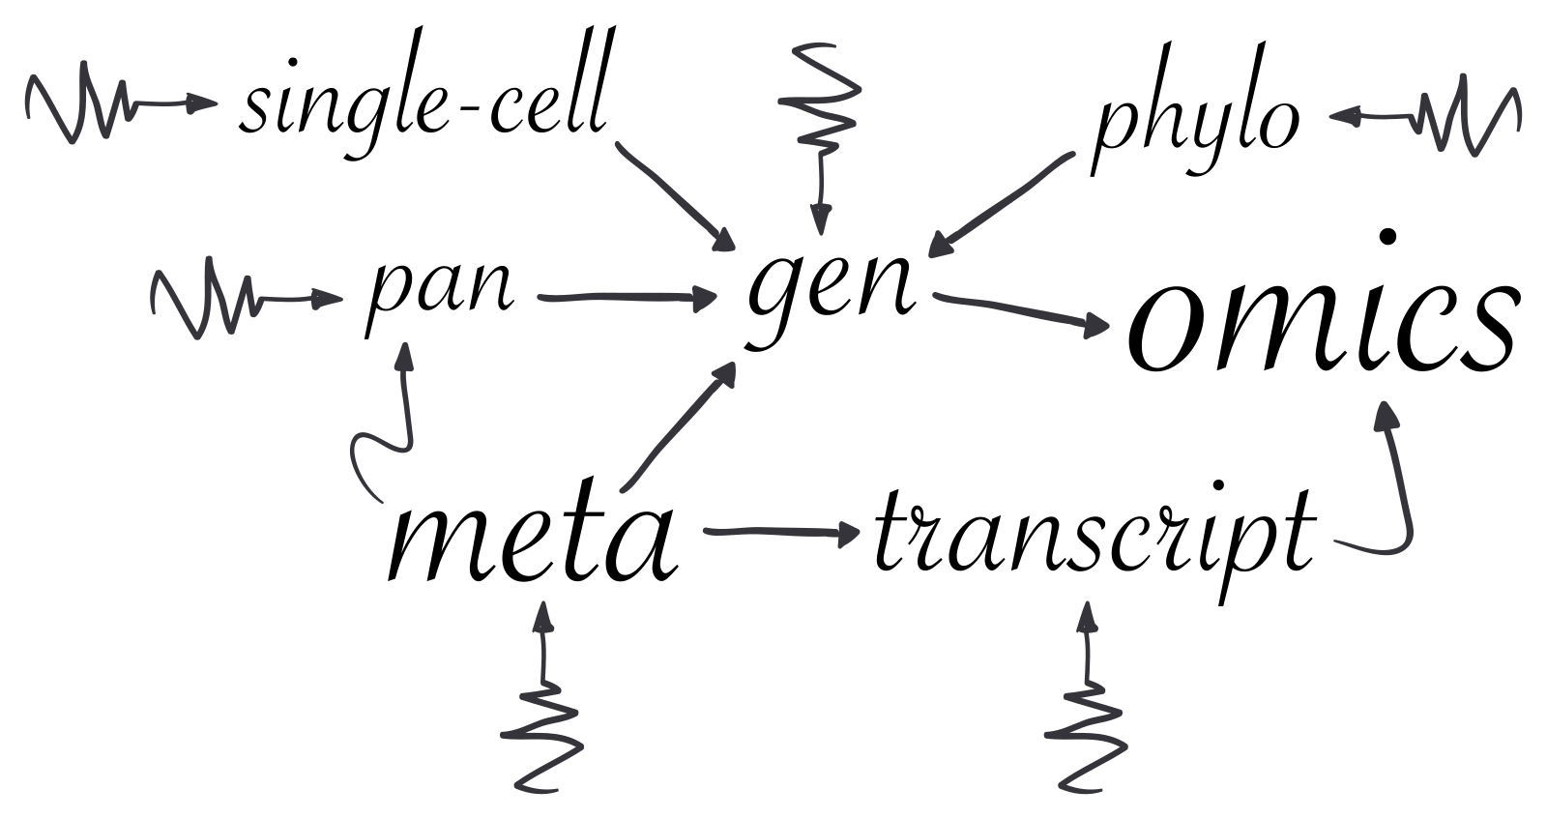
What is anvi’o?
Anvi’o is an open-source, community-driven software platform for integrated ‘omics
Notes:
it has,

Slide 5
anvi’o features
Work on many common ‘omics analyses and data types using just one software platform.

Slide 6
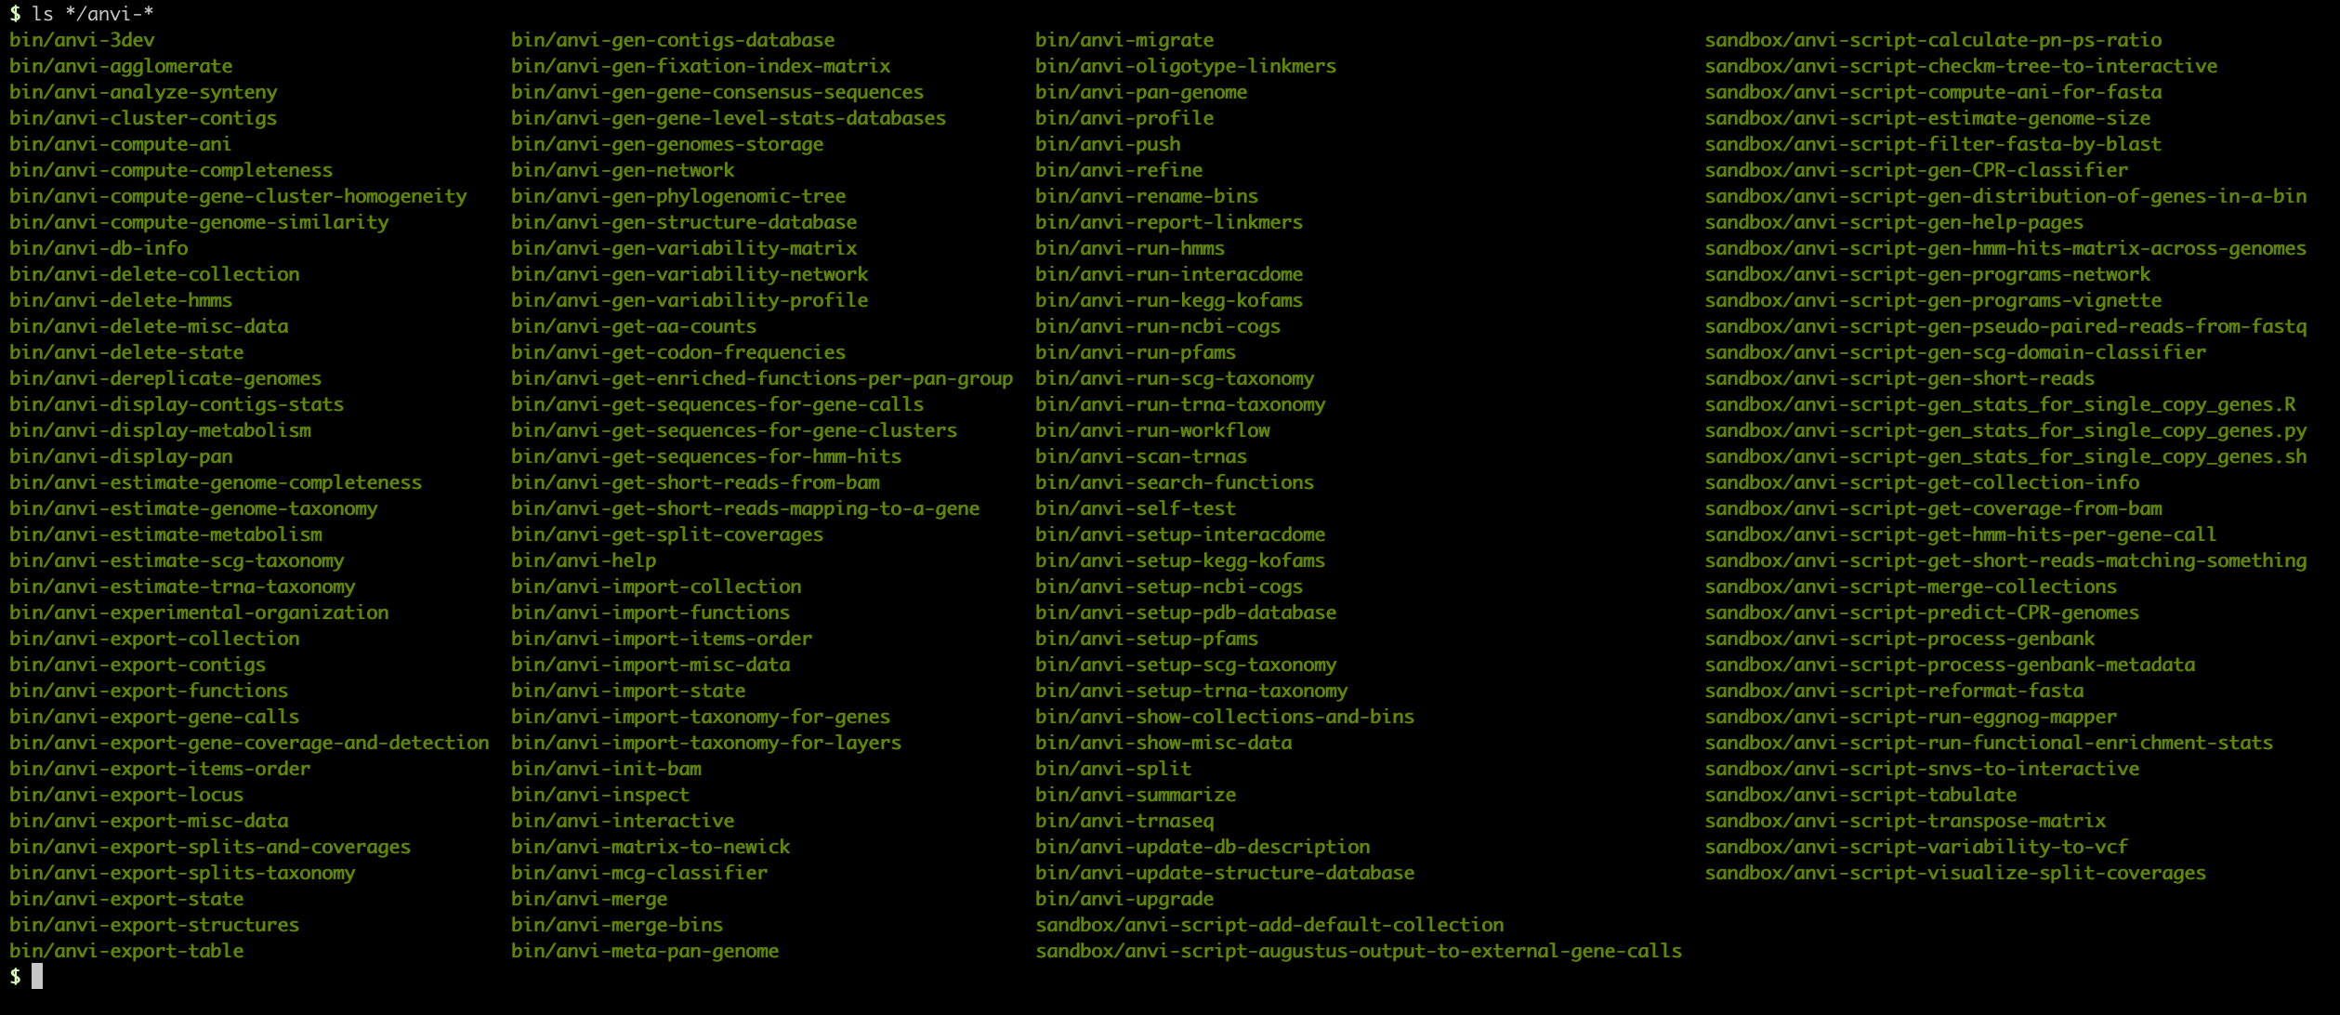
The anvi’o toolkit of programs: a computational laboratory
Notes:
Anvi’o represents a departure from the current software development practices and stands on a unique architecture that empowers its users with tremendous amount of flexibility.
For instance, anvi’o comes with a large number of small programs, each of which performs simple tasks rather than trying to accomplish entire workflows. In this sense anvi'o is a lot like LEGO: people who know their questions can piece together different components of anvi’o to implement unique workflows to address unique needs.
Different programs interface with each other through anvi'o artifacts that are generated, modified, queried, split, and merged by individual anvi'o programs.

Slide 7
anvi’o features
Work on many common ‘omics analyses and data types using just one software platform.
Visualize data to explore it interactively and download figures that are close to publication-ready.

Slide 8
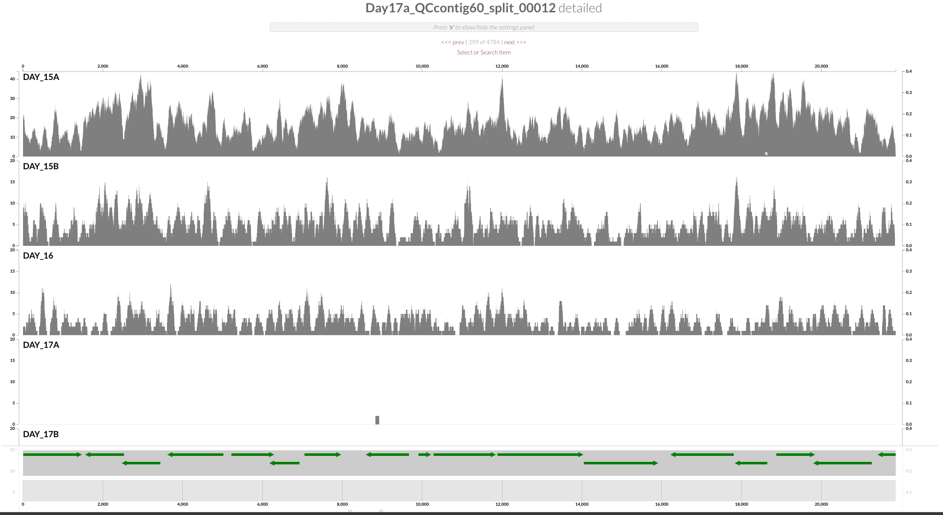
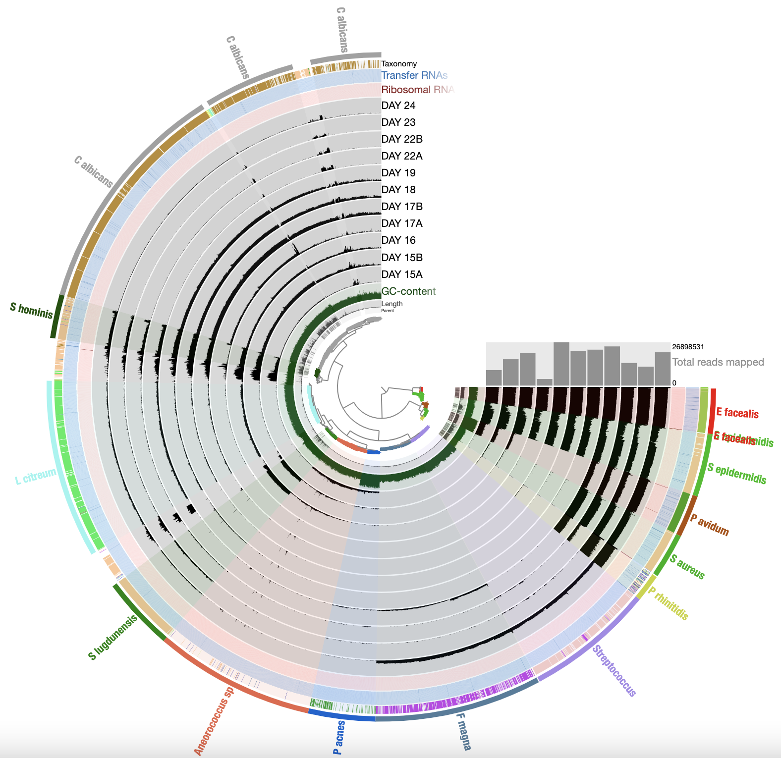

The anvi’o interactive interface
Standard interface - overview
Standard interface – inspect page

Slide 9
anvi’o features
Work on many common ‘omics analyses and data types using just one software platform.
Visualize data to explore it interactively and download figures that are close to publication-ready.
Keep sequencing data and all of its associated information together in just 1-2 databases instead of multiple text files.

Slide 10
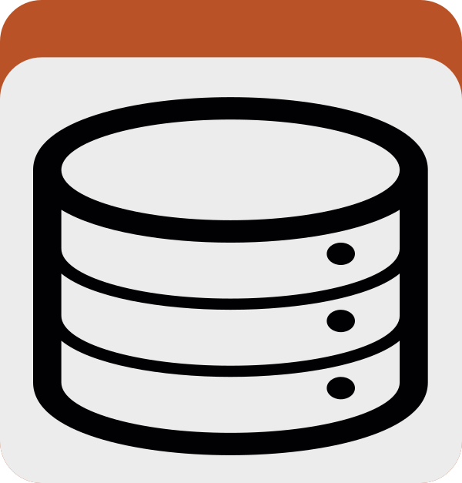
The “contigs database”
contigs
database
TATAGCATGCGTACCGATGCC…
gene-level taxonomy
single-copy
core gene
lacZ
lacY
lacA
grpE
sequence length
/ GC content

Slide 11
anvi’o features
Work on many common ‘omics analyses and data types using just one software platform.
Visualize data to explore it interactively and download figures that are close to publication-ready.
Keep sequencing data and all of its associated information together in just 1-2 databases instead of multiple text files.
Get advice from its large user community and request new programs or features from its developers.

Slide 12

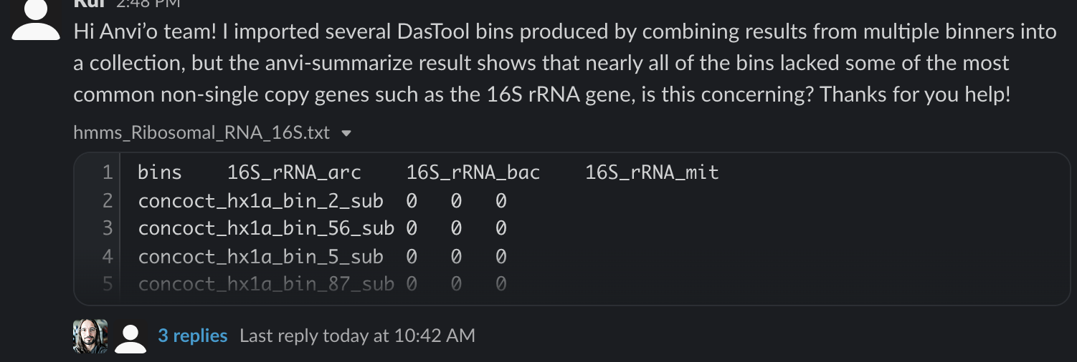
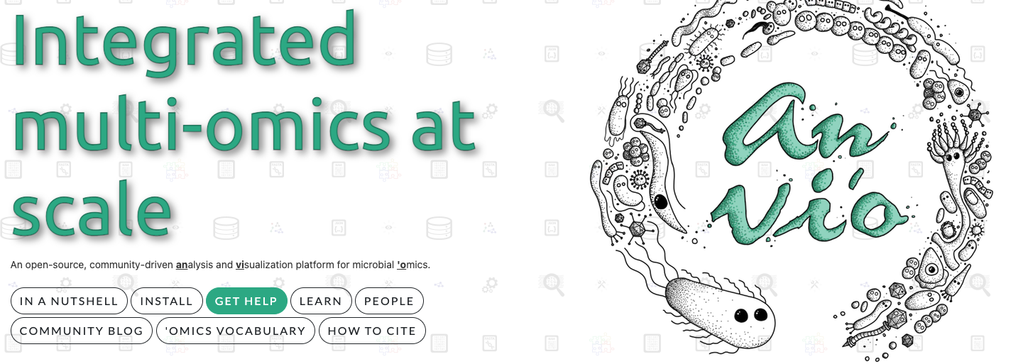
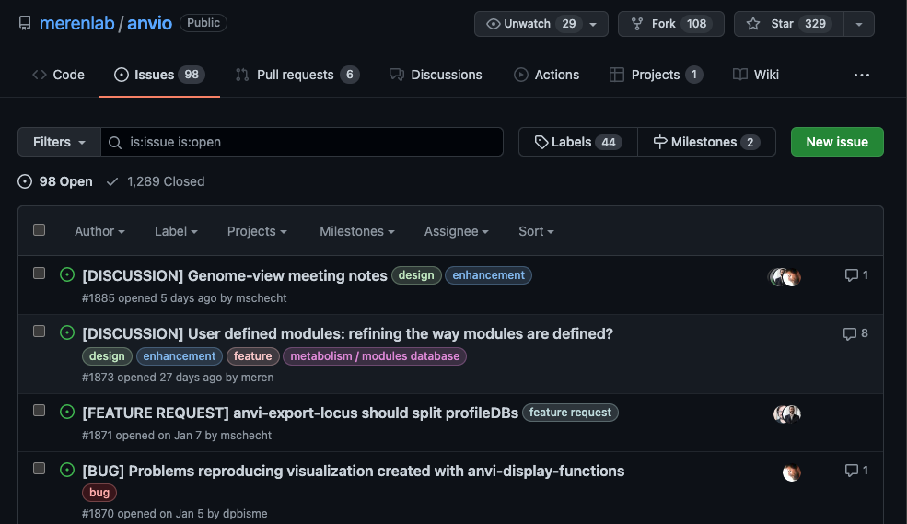



The anvi’o community
If you need advice or have a question…
If you found a bug or have an idea…

Slide 13
Hands-on Part I
Basic genome-level analyses
Notes:
these are the questions we are going to answer in the first hands on portion of this workshop

Slide 14
The “contigs database”
contigs
database
TATAGCATGCGTACCGATGCC…
gene-level taxonomy
single-copy
core gene
lacZ
lacY
lacA
grpE
sequence length
/ GC content

Slide 15
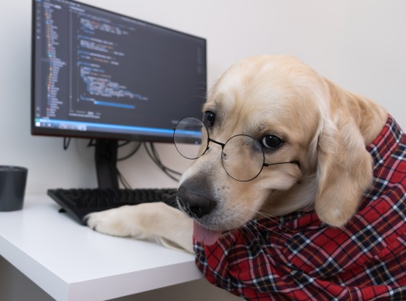
Notes:
so everyone should bring up their terminals and get ready to follow along

Slide 16
Hands-on Part II
Pan-genome analyses
Notes:
these are the questions we are going to answer in the first hands on portion of this workshop

Slide 17
The “genome storage” and “pan database”
genome
storage
Genome A
Genome B
Genome C
Genome D
Sequence alignment homogeneity
Single-copy core
pan
database
Gene cluster 1
Gene cluster 2
Gene cluster 3
Gene cluster 4

Slide 18
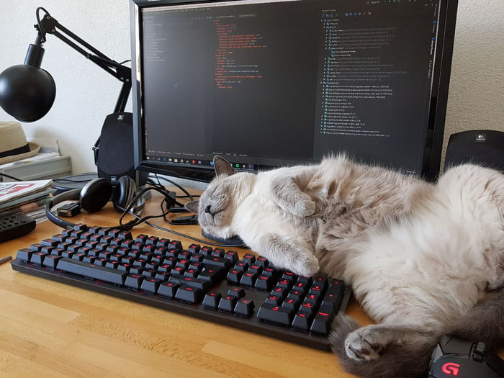

Slide 19
Hands-on Part III
Read recruitment analysis
Notes:
these are the questions we are going to answer in the first hands on portion of this workshop

Slide 20
The “profile database”
contigs
database
TATAGCATGCGTACCGATGCC…
gene-level taxonomy
single-copy
core gene
lacZ
lacY
lacA
grpE
sequence length
/ GC content
profile
database
sample 1
read mapping statistics
sample 2
variants:
A|T
G|T
T|C
C|A
G|C

Slide 21
